Slide 1

Functions & Top Down Design
Custom commands that return information

Slide 2
Modular Code
Last Few Weeks
If statements : conditions
Animation : setup, draw events
This Weeks Objectives
Top Down Design – Stepwise refinement
Functions
Consolidation

Slide 3
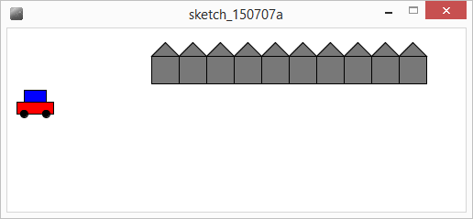
Exercise : Top Down Design
car
Row of 10 houses
Moving right to left
Wraps around
How?

Slide 4
Top Down Design: Stepwise Refinement
Driving Car
Draw background
Draw Car
Draw background
draw 10 adjacent houses
move background
Draw Car
draw car body : red
draw car top : blue
draw wheels
Top level headings
level headings
become Procedure names
level headings
become Procedure names

Slide 5
Top Down Design: Stepwise Refinement
Needs parameters
Draw Car
draw car body : red
draw car top : blue
draw wheels
Draw Car(x,y,size)
Fill(red)
Rectangle(x,y,width,height)
Fill(blue)
Rectangle(x+offset,topWidth, topHeight)
Circle(leftx,wheely,wheelHeight)
Circle(rightX,wheelY,wheelHeight)
Needs local vars

Slide 6
Top Down Design: Stepwise Refinement
Draw background
Draw Car
Draw background
draw 10 adjacent houses
move background
Draw Car
Draw background
for 10 repetitions
draw house(position,size)
move right a houseWidth
Move position left;
Draw house(x,y,size)
square(x,y,size);
Triangle(x,y,size);
Add detail

Slide 7
Stepwise Refinement
Breaking down a problem into subproblems – recursively
Refine(problem)
If problem can be stated (unambiguously) as code
done – keep statement
Else
{
take problem and break into set of subproblems
For each subproblem
Refine(subproblem)
}
Define program in terms of headings
Take each

Slide 8
Stepwise Refinement - iterative
Take Current Problem as a heading
Write down the steps to complete the problem
Each step is a subproblem (a subheading)
If (step is too complex to be converted into a programming command)
repeat from step 1.
Approach frequently leads to well-structured, maintainable code
usually 3 or 4 levels is sufficient
Notes:
Breaking problem down in this fashion is thinking like a programmer!
Used universally to solve problems – set subtasks

Slide 9
Stepwise Refinement : Tree view
Driving car
Draw Background
Draw Car
Draw wheels
Draw 10 Houses
Move Position left
Draw top
Draw body
Draw House
Draw House
Draw House
Draw House
Draw right wheel
Draw House
Draw left wheel
Draw House
Draw Square
Draw Triangle
Each box – is a block of code
Possible Procedure

Slide 10
Stepwise Refinement : Tree view
Driving car
Draw Background
Draw Car
Draw wheels
Draw 10 Houses
Move Position left
Draw top
Draw body
Draw House
Draw House
Draw House
Draw House
Draw right wheel
Draw House
Draw left wheel
Draw House
Draw Square
Draw Triangle
Traversed – depth first
as program runs

Slide 11
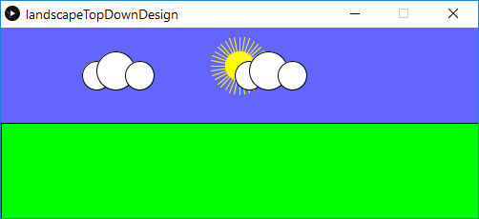
Exercise: Landscape, 3 levels
Draw Land
Fill(green)
Draw rectangle
Draw Sky
Blue background
Sun
Cloud(position 1)
Cloud(position 2)
Sun
Fill (yellow), stroke
Rays – for loop
circle
Landscape
Draw Sky
Draw Land
Cloud(x, y)
Fill(white)
circle(x,y,medium)
circle(x+?,y-?,large)
circle(x+?,y-?,small)
Notes:
Have a go

Slide 12
Procedures & Functions
Revision
Procedure(s) : block of code that performs a task, e.g. draw an eye
Code runs when called as a command
Used to “package” a commonly used sequence of instructions
Functions work in same way, but also return some information
E.g. get(x,y) color pixelColour = get(25, 25);
get returns the colour of the pixel at x,y

Slide 13
Functions
Procedures – preceded by void
Procedures return no information
void circle(int x, int y, int size)
Functions preceded by return type
Functions return information so have a TYPE (not void)
color get(int x, int y)

Slide 14
Using functions
Function call must be on right hand side of an assignment
Catch the returned value
boolean collision(int x, int y)
float max(float num1, float num2)
color get(int x, int y)
How could we use get to compare the colour of two pixels at 10,10 and 100,100?
if (collision(100,50))
//draw explosion
float big = max(20,50);
color pixel1 = get(10,10);
color pixel2 = get(100,100);
if (pixel1 == pixel2)
//detected same color
if ( get(10,10) == get(100,100) )
//detected same color

Slide 15
Function operation
20
5
int max(int num1, int num2)
{
if (num1>=num2)
return num1;
else
return num2;
}
Function ends as soon as
it hits a return statement
5
x
int x=5;
void draw()
{
int big = max(20,x);
x=x+10;
..
}
20
20
big
Calls function max passing
20 to num1, 5 to num 2

Slide 16
Writing Functions
Write a function to calculate area of a rectangle
What information (parameters) would it require?
What return type would it be?
float areaRectangle(float width, float height)
Write the code

Slide 17
Solution : areaRectangle
float areaRectangle(float width, float height)
{
float result; //local variable for the answer
result = width * height;
return result; //send result back
}
void setup()
{
int area = areaRectangle(100,75); //using function
}

Slide 18
Summary
Problem decomposition
Top down design
Stepwise refinement
Help to design code solutions
Functions
Using, writing
Color type

